Slide 1

WEB SCRAPING PROJECT IMDb - What determines Top 50 Action-Movie's Success
BY
MICHAEL DARKOH

Slide 2

TABLE OF CONTENTS
Research Question
Scrape Website
Illustration and Challenges
Demo and Code
Result and Findings
Conclusion

Slide 3

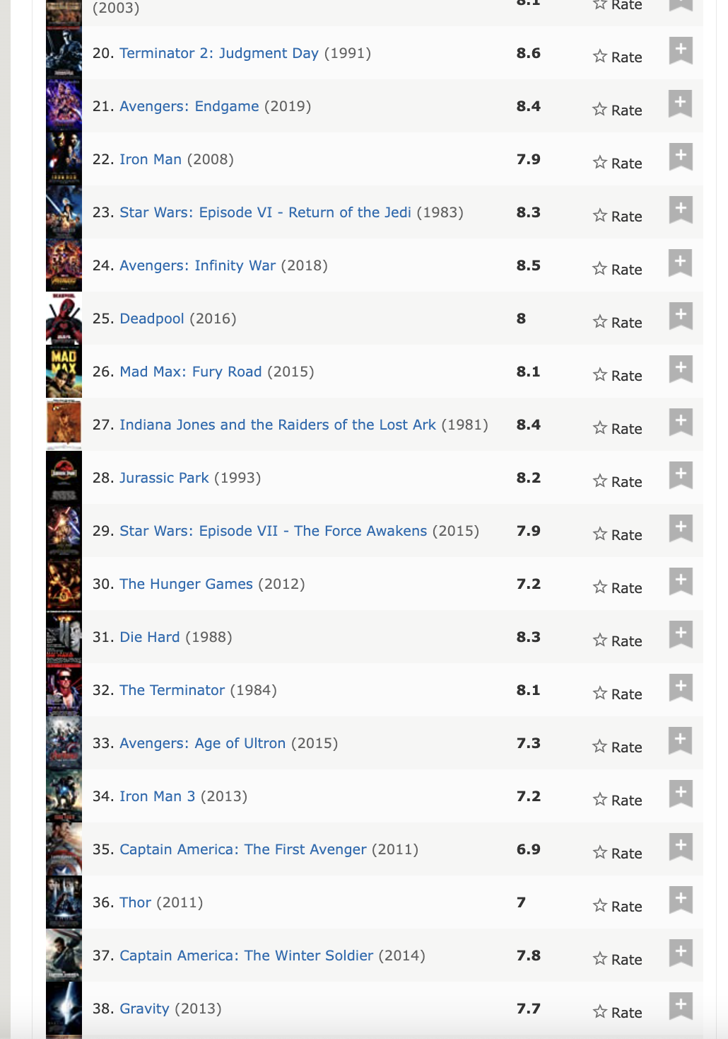
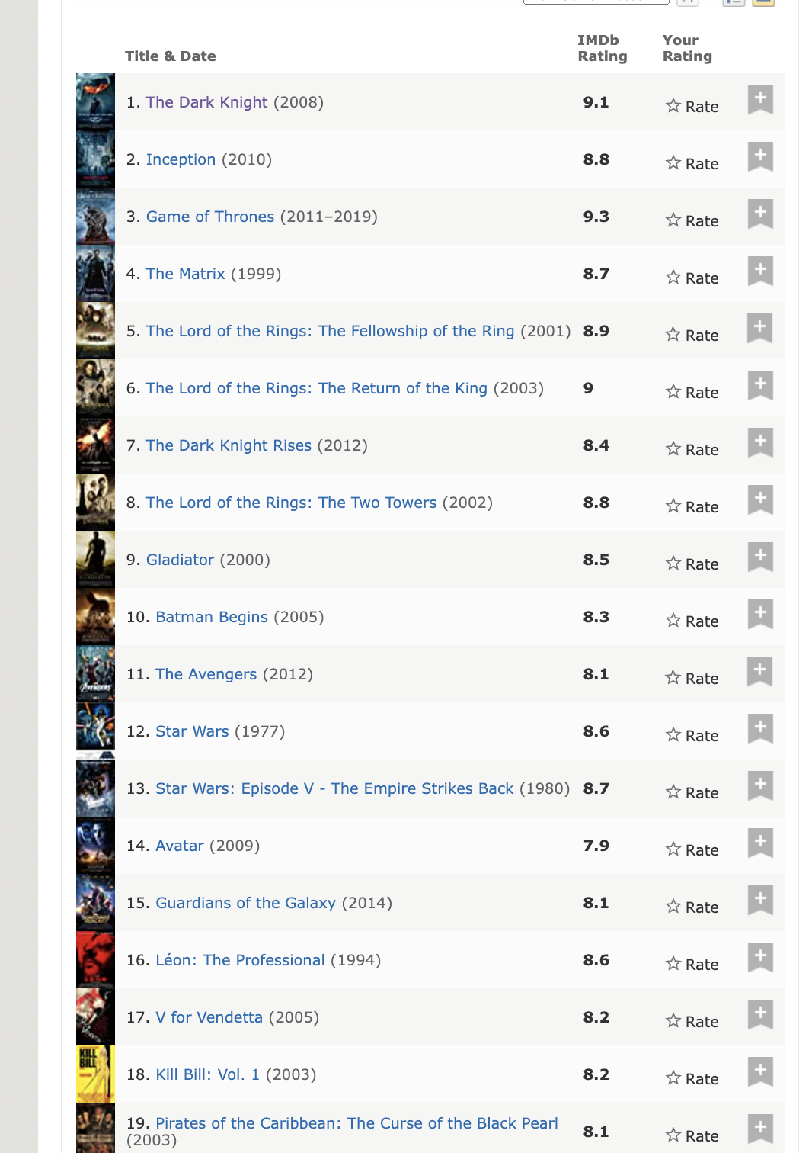
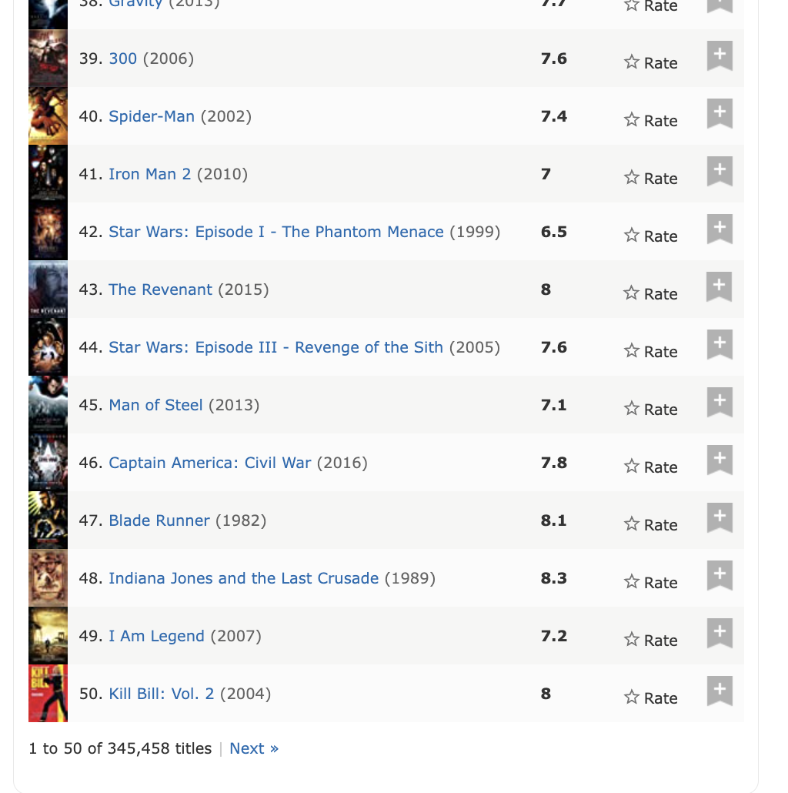
Research Question
What is the Research Question?
What determines “Top 50 Action-Movies’” success.
According to IMDb.com here are the top 50 action movies based on votes.

Slide 4
Scrape Website
What website did I scrape.
I scrape IMDB.com
URL https://www.imdb.com/search/keyword/?ref_=kw_vw_smp&mode=simple&page=1&genres=Action&sort=num_votes,desc
Why this website?
I am a fan of action movies, I found it exciting and interesting on how much earnings are made from these action movies and to determine if the movie was a success.

Slide 5
Illustrations and Challenges
How I went about it.
I used selectorGadget to identify the CSS and the xpath.
I named my final data as Action Movie.
I will demo on the next slide.
Difficulties
Matching the observations for each column. Example; [1:50]
Replacing missing values with “NA”.
Interest
Finding how relationship between rating and votes contribute to the success of Action-movies.
Finding out the relationship between Gross and Rating.

Slide 6
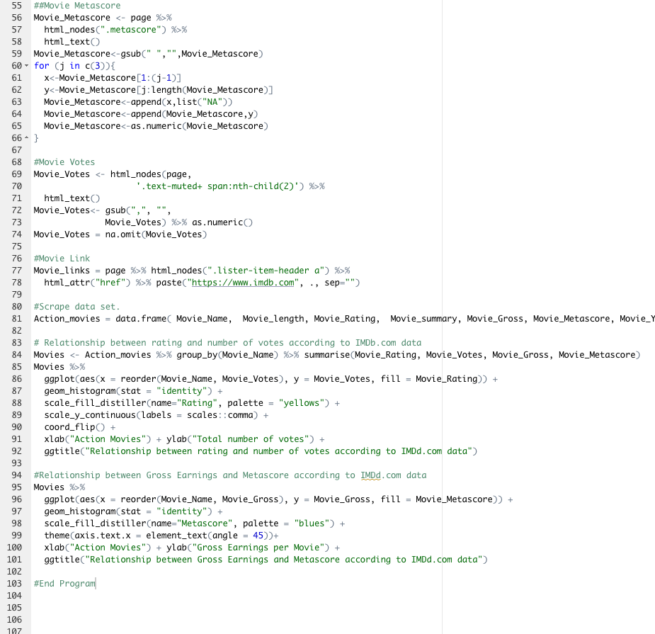
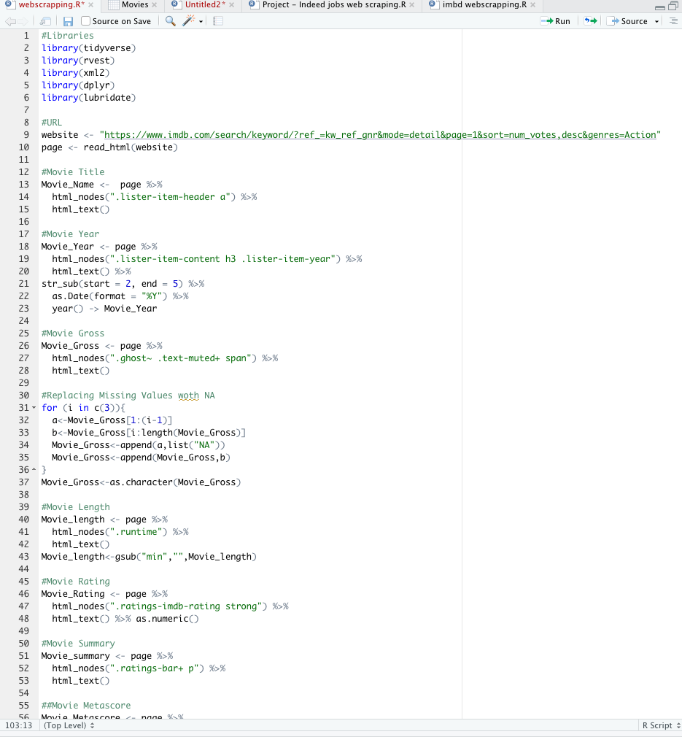
Demo
I will be showing the demo and attached is the code.

Slide 7
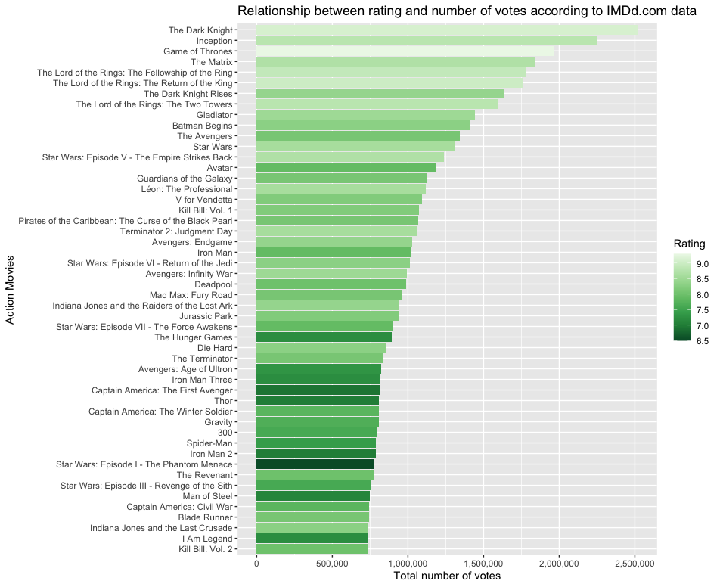
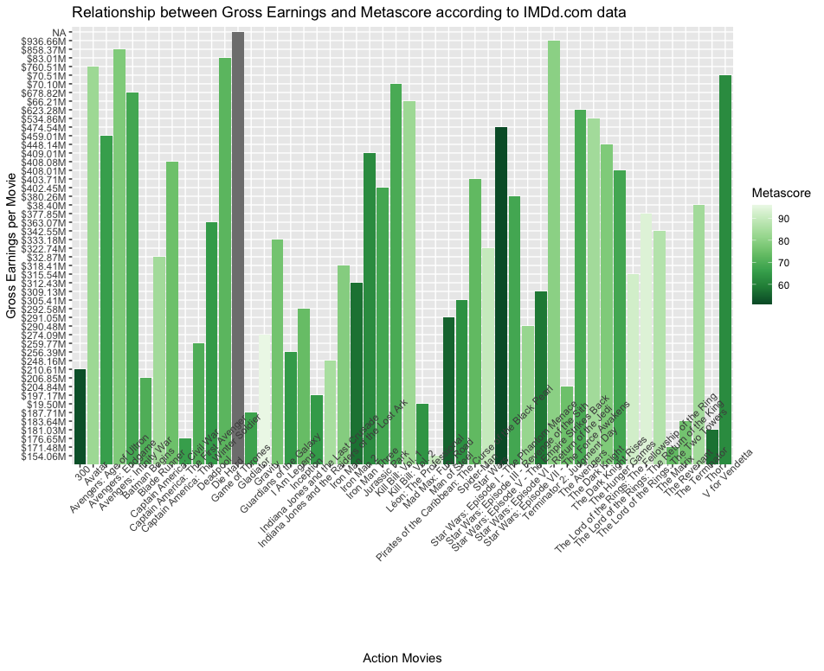
Results and Findings

Slide 8
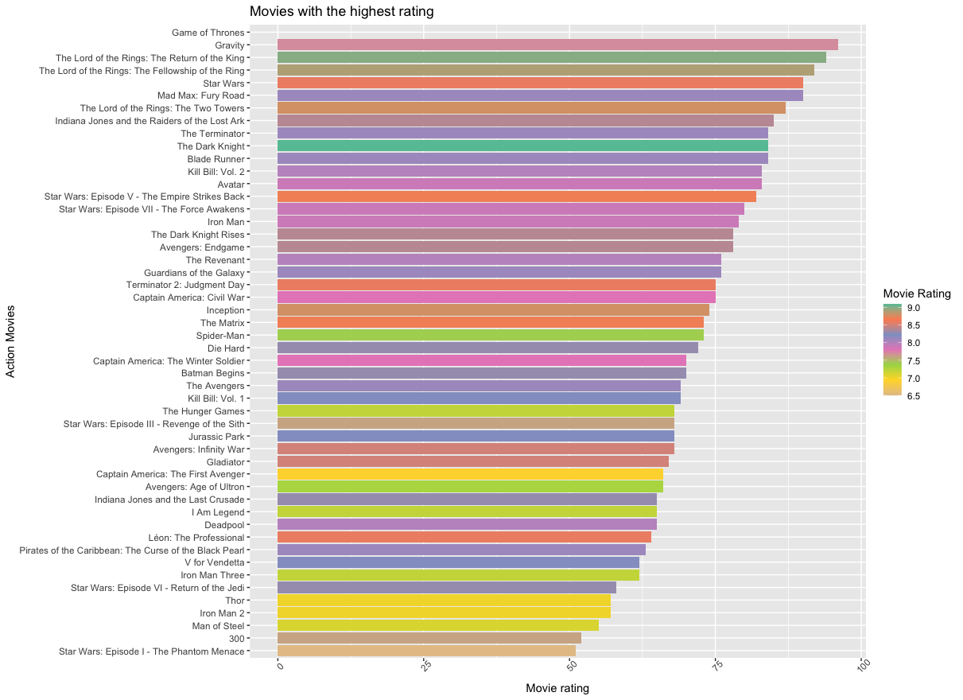
Additional findings

Slide 9
Conclusion
We find out that Gross Earnings contributes to the success of an action, which indicates, there were lot of people who watched that action movie. From the data, we realized Star War: Episode VII- the force has the highest earnings and with a metascore of 80.
We find out that The Dark Knight has the highest recorded votes and with a rating of 9.1
Overall, Star War: Episode VII- the force and The Dark Knight was successful movies.
Gravity and the lord of The Lord of the rings have the highest Metascore meaning these movies had the most positive review critics.

